Slide 1
Sub:
CACD
Skill-9
Implementation of ARP Poisoning Using Ettercap Tool

Slide 2
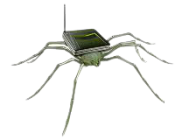
Skill-9
Implementation of ARP Poisoning Using Ettercap Tool
Sub:
CACD
So Now We Will Be Working On EtterCap
What Is Ettercap ?
So Basically, Ettercap Is A Combination Of MITM Tools Usually Used For Doing Man-In-The-Middle Attacks On The LAN Network That Can Help in Auditing Security & Analysing Computer Network Protocols
As Every Tool Got It’s Alternative, Ettercap Also Got Its Alternative Tool Too Named Bettercap, Which Basically Named Like That To Show That It Is Better Than Ettercap. So, Spell It As “Better-cap”
Thinking Why Still Ettercap Is Being Taught, Coz It Is The Standard And Easy For The Beginners To understand The Settings And Configurations
Warning:
Doing MITM Attacks For Whatever LAN You Like Might Lead You To The Risk, So You Better Be Careful Before Attacking Anything That You Don’t Have Permissions To
Be Anonymous, Be Safe

Slide 3
Skill-9
Implementation of ARP Poisoning Using Ettercap Tool
Sub:
CACD
ETTERCAP
Multipurpose Sniffer/Interceptor/Logger
Note: For This You Have To Use Some Fake Login Request Sending Sites, Try Searching Some Sites Or Use Some From Here: bit.ly/cacd-skill9

Slide 4
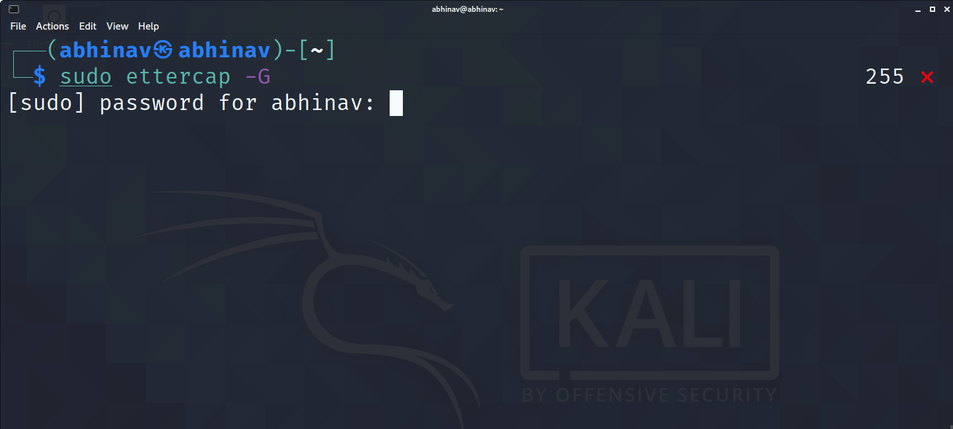
Skill-9
Implementation of ARP Poisoning Using Ettercap Tool
Sub:
CACD
ETTERCAP
Open Command Prompt And Type sudo Ettercap –G. Which Is Nothing But Opening Ettercap In Graphical Mode With Administrator Permission

Slide 5
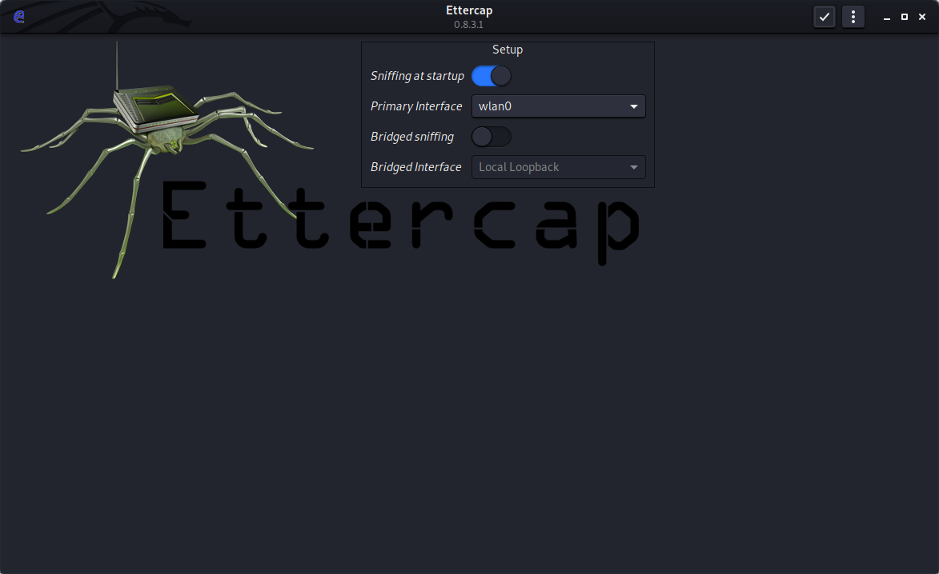
Skill-9
Implementation of ARP Poisoning Using Ettercap Tool
Sub:
CACD
ETTERCAP
After Executing The Previous Command, You Would Be Seeing An Ettercap Tool Like The Below Popping Out

Slide 6
Skill-9
Implementation of ARP Poisoning Using Ettercap Tool
Sub:
CACD
ETTERCAP
In The Box You Could See A Small Setup Dialogue Box, There Set The Primary Interface To Your Respective LAN Type [eth0 or wlan0] And Everything As Default. Now Click On The Accept Box{}

Slide 7
Skill-9
Implementation of ARP Poisoning Using Ettercap Tool
Sub:
CACD
ETTERCAP
Now After You Are Done With Setting Up The Setup, Click On The Tick[✓] Box To Confirm The Setup

Slide 8
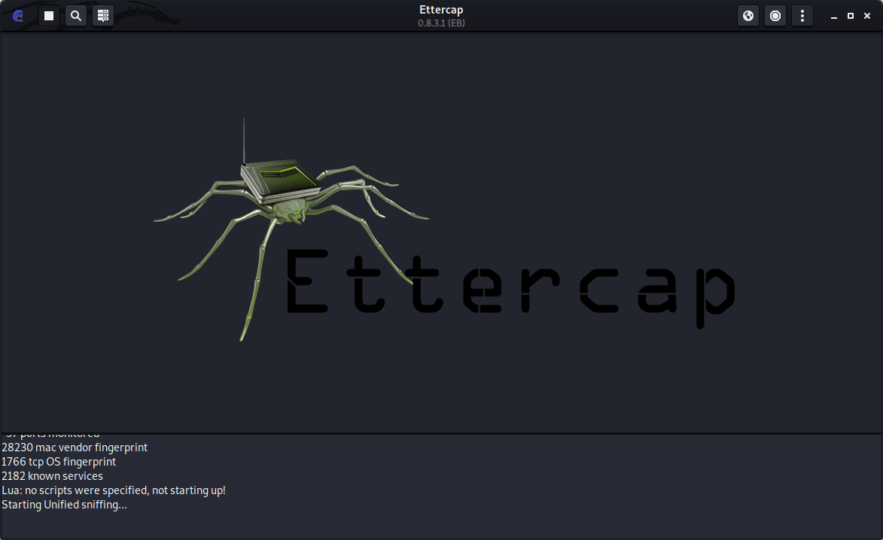
Skill-9
Implementation of ARP Poisoning Using Ettercap Tool
Sub:
CACD
ETTERCAP
After Clicking The Tick[✓] Box, You Could See A New Unified Sniffing Process Gets Started As Seen In Below Pic

Slide 9
Skill-9
Implementation of ARP Poisoning Using Ettercap Tool
Sub:
CACD
ETTERCAP
Click On The Three Dots At The Top Right Corner To See The Menu List

Slide 10
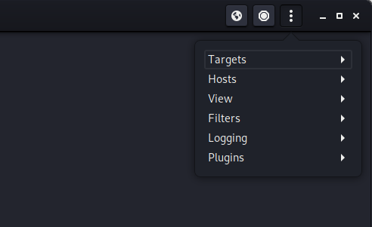
Skill-9
Implementation of ARP Poisoning Using Ettercap Tool
Sub:
CACD
ETTERCAP
You Can See Various Options In The Dropdown menu List, No Click On Hosts

Slide 11
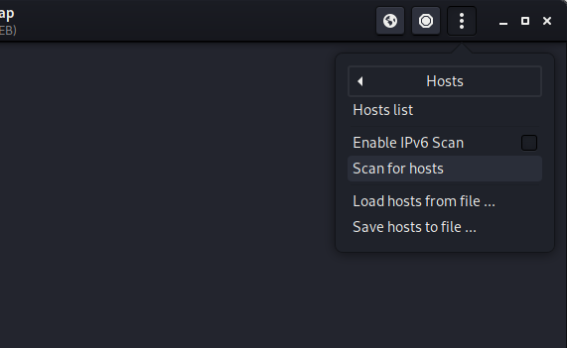
Skill-9
Implementation of ARP Poisoning Using Ettercap Tool
Sub:
CACD
ETTERCAP
Now In The Hosts Section Click on Scan For Hosts, To Check For The Devices Connected To A Particular Wifi

Slide 12
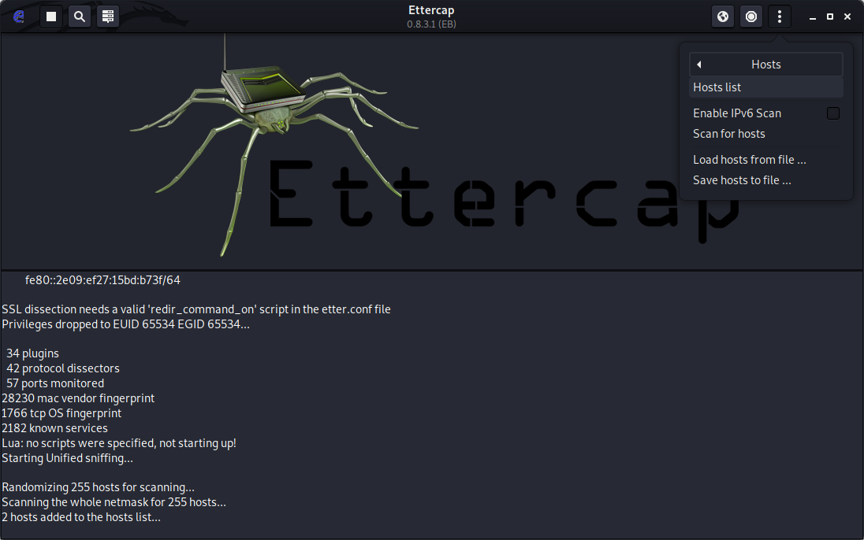
Skill-9
Implementation of ARP Poisoning Using Ettercap Tool
Sub:
CACD
ETTERCAP
Now In The Console Box, It Scans All The 255 Hosts Randomly And Adds The Connected Hosts To The Hosts List

Slide 13
Skill-9
Implementation of ARP Poisoning Using Ettercap Tool
Sub:
CACD
ETTERCAP
To View The Hosts Again Click On Three Dots(⋮) -> Hosts -> Hosts List

Slide 14
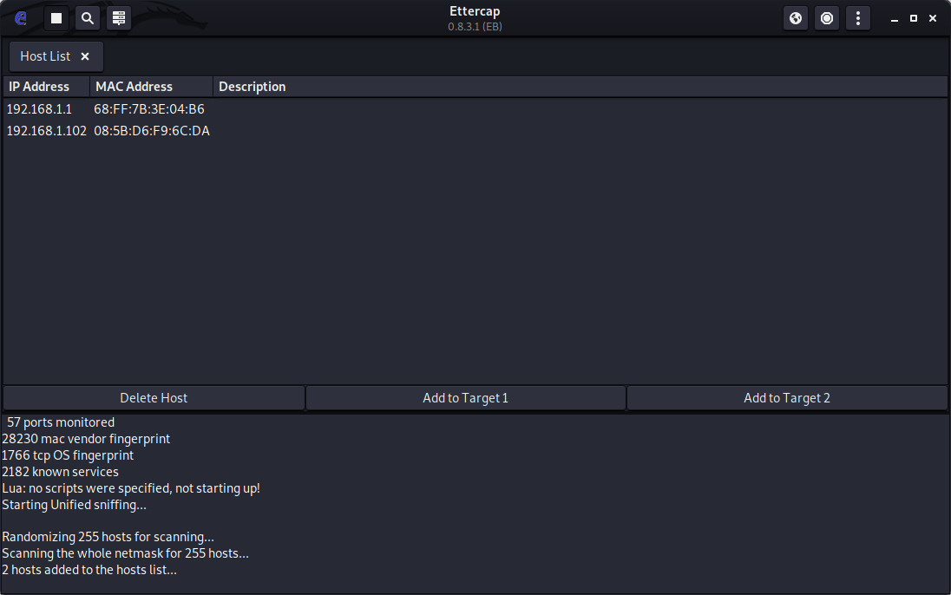
Skill-9
Implementation of ARP Poisoning Using Ettercap Tool
Sub:
CACD
ETTERCAP
Here In the New Screen, you Could See The List Of All The Hosts That Scanned Up

Slide 15
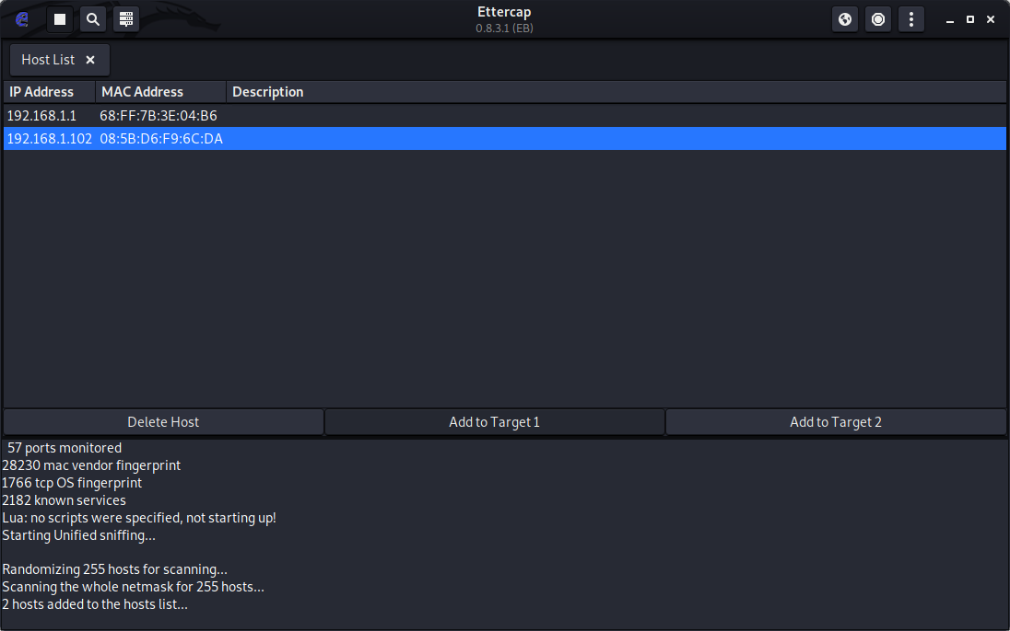
Skill-9
Implementation of ARP Poisoning Using Ettercap Tool
Sub:
CACD
ETTERCAP
In The List Of All The Hosts You Got, Select Your Desired Host & Click On “Add To Target1”

Slide 16
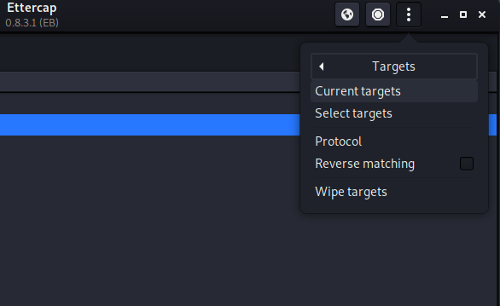
Skill-9
Implementation of ARP Poisoning Using Ettercap Tool
Sub:
CACD
ETTERCAP
Now After Adding The Hosts To The Target Click On Three Dots(⋮) -> Targets -> Current targets To View The Targets List

Slide 17
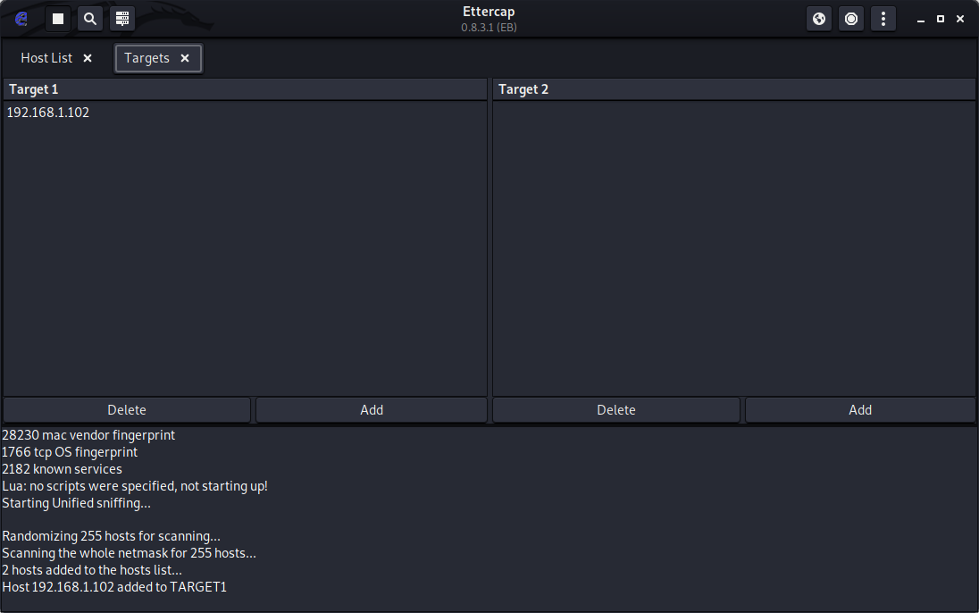
Skill-9
Implementation of ARP Poisoning Using Ettercap Tool
Sub:
CACD
ETTERCAP
Here A New Tab Gets Opened, There You Could See The Targets You Have Been Added So Far

Slide 18
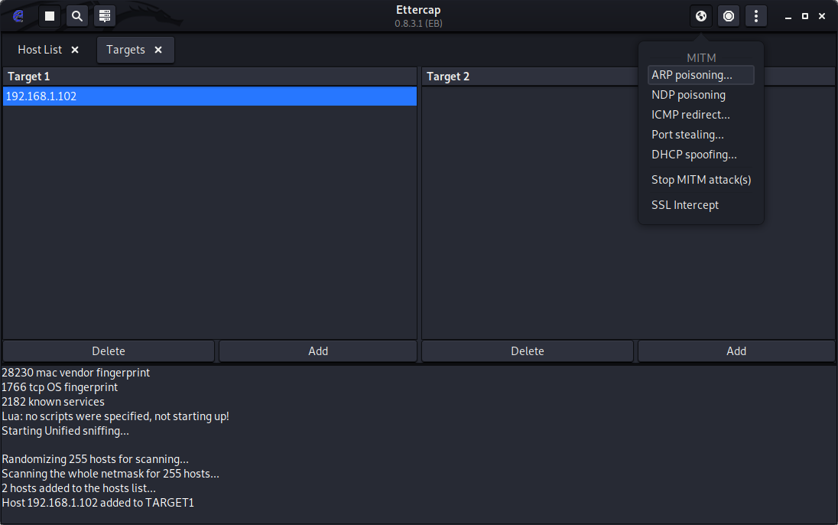
Skill-9
Implementation of ARP Poisoning Using Ettercap Tool
Sub:
CACD
ETTERCAP
Now In The Targets Tab, Select Your Main Target You Wanted To Attack

Slide 19
Skill-9
Implementation of ARP Poisoning Using Ettercap Tool
Sub:
CACD
ETTERCAP
Upon Selecting The Target Click On MITM Attacks Icon To Get The Various Lists Of MITM Attacks Menu, As Of Now We Will Be Dealing With ARP On This Skill, Click On ARP Poisoning.

Slide 20
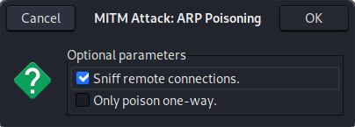
Skill-9
Implementation of ARP Poisoning Using Ettercap Tool
Sub:
CACD
ETTERCAP
On Selecting The Arp Poisoning You Will Seeing A Dialogue box With Two Check boxes, Ensure You Check The First Option[Sniff Remote Connections] . After Checking Click On “Ok”

Slide 21
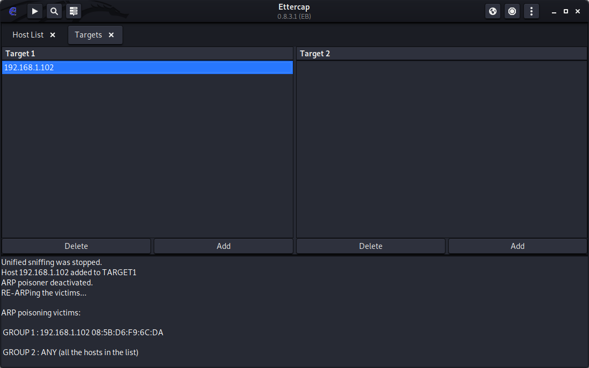
Skill-9
Implementation of ARP Poisoning Using Ettercap Tool
Sub:
CACD
ETTERCAP
After Completing The Previous Step, You Could See In The Console That ARP Poisoning Is Enabled For The Victim

Slide 22
Skill-9
Implementation of ARP Poisoning Using Ettercap Tool
Sub:
CACD
ETTERCAP
And Finally, To Start Sniffing Details. Click On Start Sniffing[ ], To Get The Login Details Of The Victim. If At All You See That Already Sniffing Has Been Started Just Restart The Sniffing

Slide 23
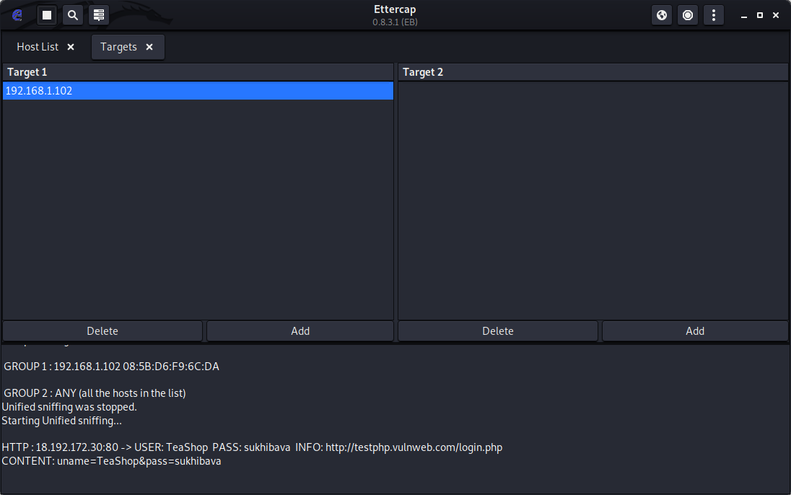
Skill-9
Implementation of ARP Poisoning Using Ettercap Tool
Sub:
CACD
ETTERCAP
And Now That You Could See That Unified Sniffing Has Been Started On The Victim Actions, Now The Only Thing You Should Do Is To Wait For The Victim To Login To Any Of The Site To Get The Details

Slide 24

Skill-9
Implementation of ARP Poisoning Using Ettercap Tool
Sub:
CACD
ETTERCAP
Hurray..!!!!!!!!
Successfully Done Up Setting Up The Groundwork Required For Capturing The Details Of The Victim
Now Let’s Go To The Victim Computer And Do The Login Work To Save The Time

Slide 25
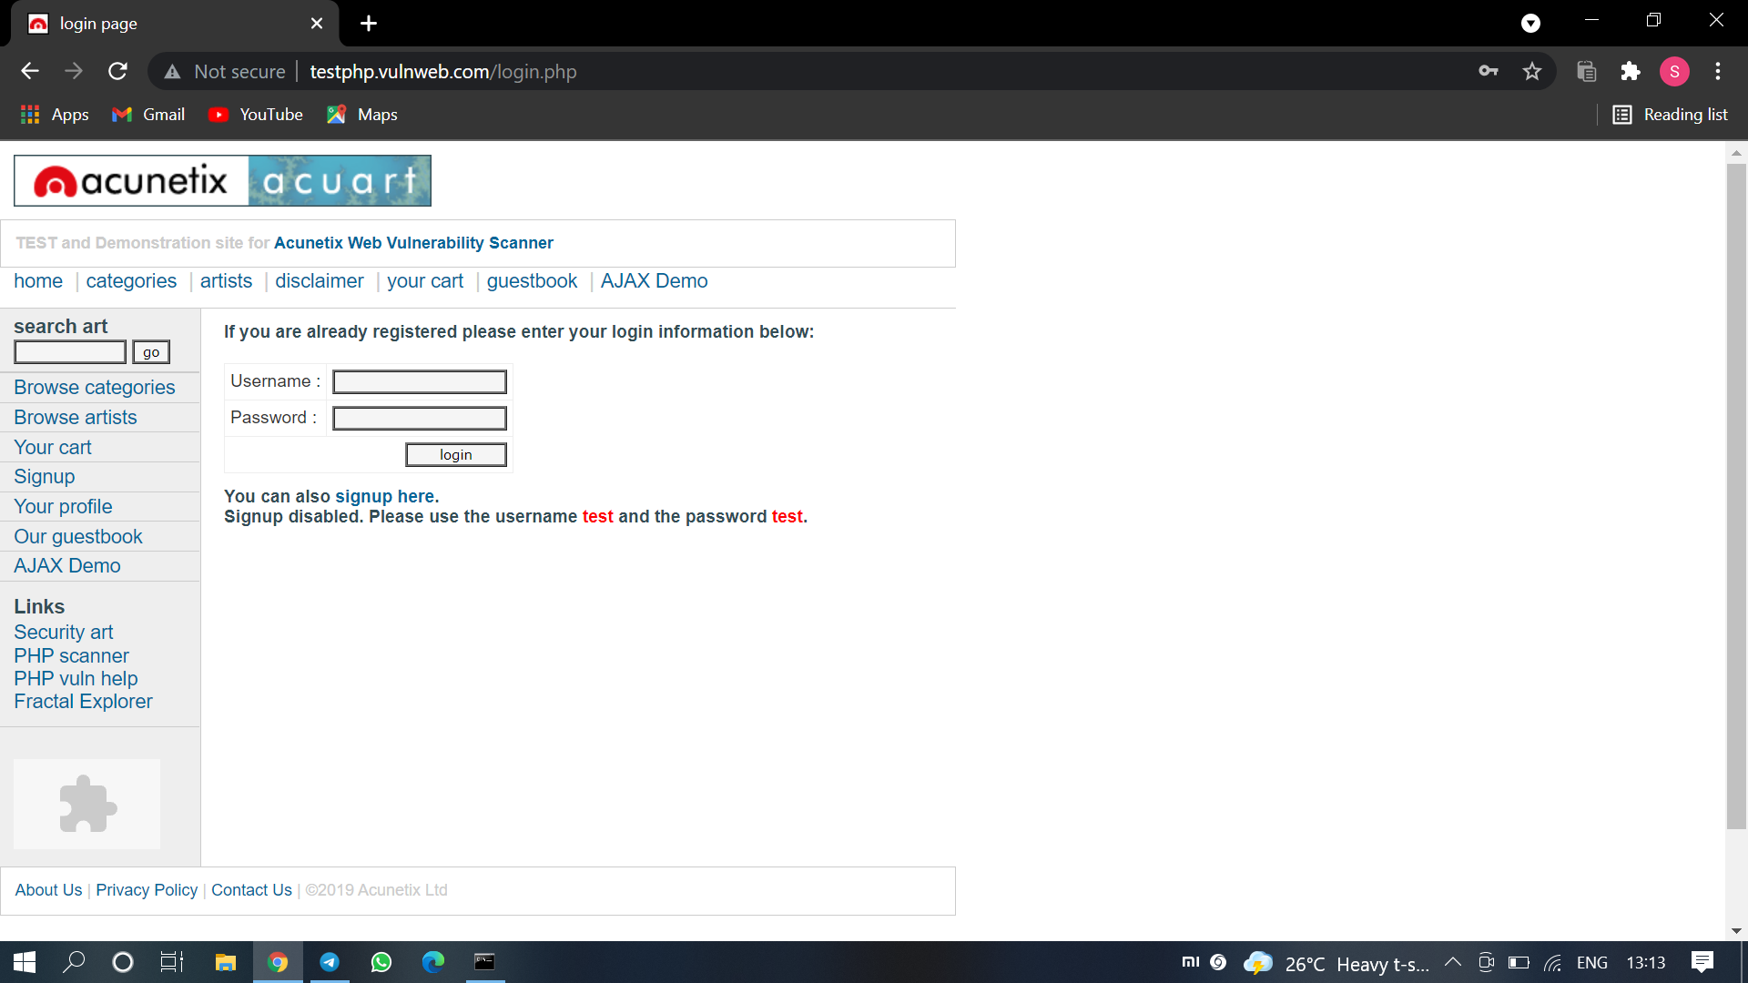
Skill-9
Implementation of ARP Poisoning Using Ettercap Tool
Sub:
CACD
ETTERCAP
Open Any Of The Links From The Given URL [bit.ly/cacd-skill9]

Slide 26
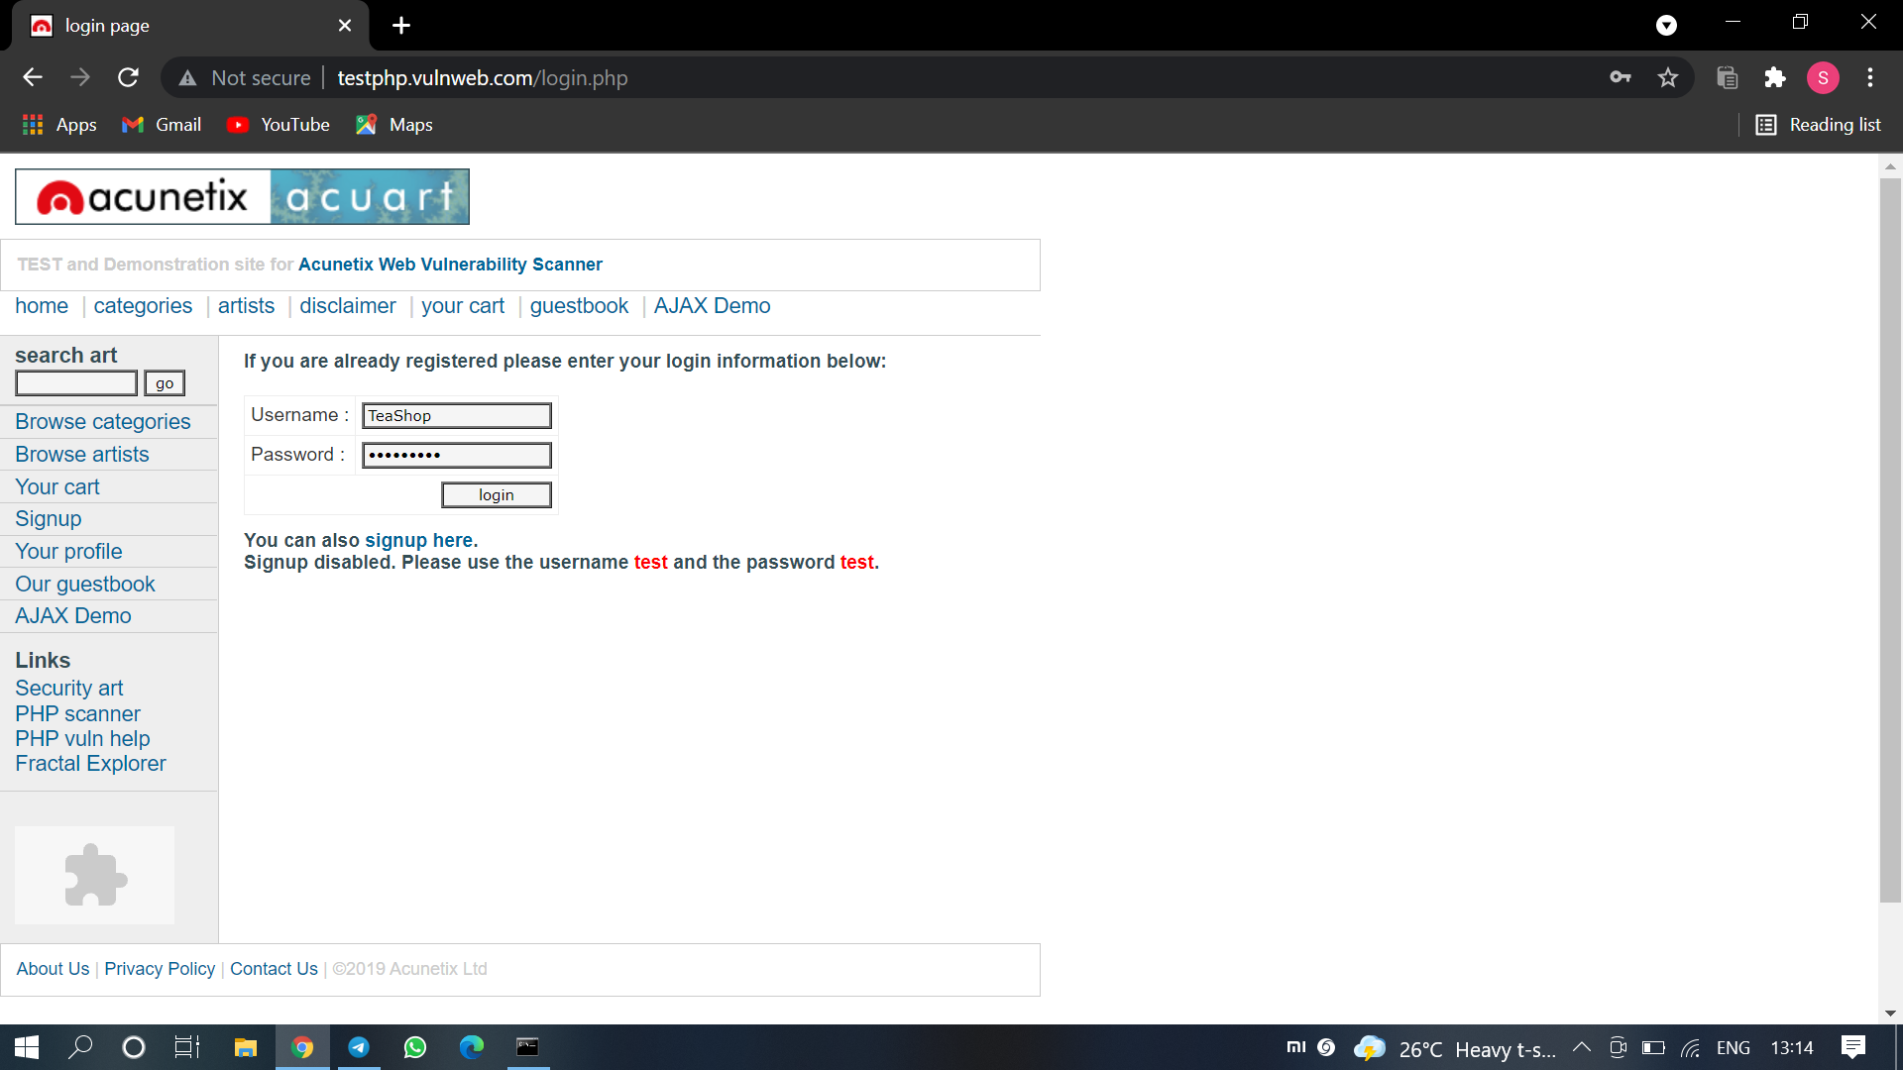
Skill-9
Implementation of ARP Poisoning Using Ettercap Tool
Sub:
CACD
ETTERCAP
Fill Some Random Details In The Username & password Input And Click Login. Nothing Happens In Frontend, But A Request Is Generated In Back, But That Request Is Sniffed By The Attacker Who Is Waiting In Ettercap

Slide 27
Skill-9
Implementation of ARP Poisoning Using Ettercap Tool
Sub:
CACD
ETTERCAP
Now Let’s Move On To The Attacker’s System Check Whether Attacker Got The Details Of The Victim From The Generated Request

Slide 28
Skill-9
Implementation of ARP Poisoning Using Ettercap Tool
Sub:
CACD
ETTERCAP
That’s It, You Got The Login Credentials Of The Victim In The Console Box. It’s Your Turn Now On How To Use Them.
Game Over

Slide 29
Skill-9
Implementation of ARP Poisoning Using Ettercap Tool
Sub:
CACD
ETTERCAP
Let’s Analyse Deeper On Sniffed Data We Got In The console
HTTP: Gives The IP Address Of The Site, Where The Request Came From
USER: Shows The Username Input Field Value
PASS: Shows The Password Input Field Value
INFO: Gives The URL Where The Request Is Coming From in A Readable Format
CONTENT: Shows What Is Being Passed In The Request

Slide 30

Skill-9
Implementation of ARP Poisoning Using Ettercap Tool
Sub:
CACD
ETTERCAP
Boooom..!!!!!!!!
We Have Successfully Completed The ARP Poisoning And Pulled In The Credentials Of The Victim Using Ettercap
Warning: Hacking Is Illegal, Do It On Your Own Risk

Slide 31
Skill-9
Implementation of ARP Poisoning Using Ettercap Tool
Sub:
CACD
Pros Of Ettercap:
Ease of access. Beginners can easily cope up with the tool, with easy navigations and understandability
Amongst all these, the wide range of features in Ettercap makes it easy for a malicious actor to perform reconnaissance on a network before starting session hijacking attack

Slide 32
Skill-9
Implementation of ARP Poisoning Using Ettercap Tool
Sub:
CACD
Cons Of Ettercap:
Outdated Version, It Has Been Over Four Years Since It’s Last Update Has Been Pushed Out To Users
Only Supported In MAC & Linux, Sad To hear If You Use Any Other OS, You Are Not Able To Have A Hands On It
It Requires A Lot Of Internal Storage. As It Deals With Several Dependencies & Developer Libraries In Order To Function Properly
If Any Of The Dependency Or Library Gets Removed The Whole App Gets Ruined Off, Reinstallation is the Only Option For Fixing It Which Takes A Lot Of Time

